Slide 1
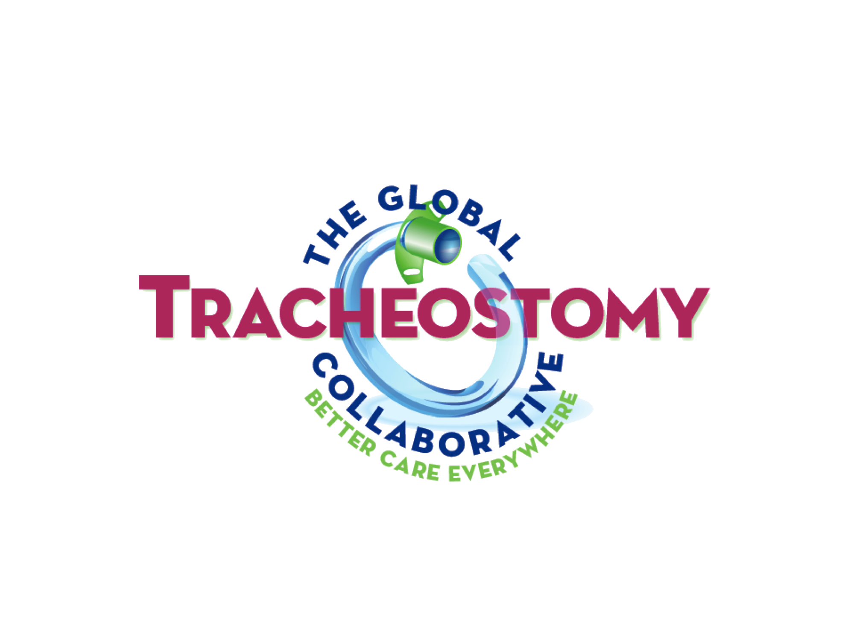
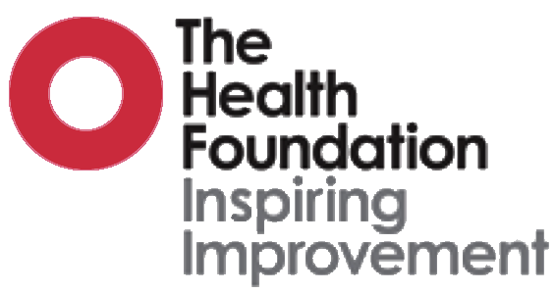
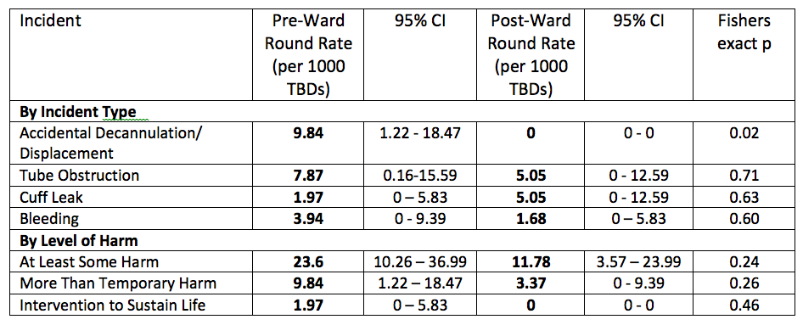
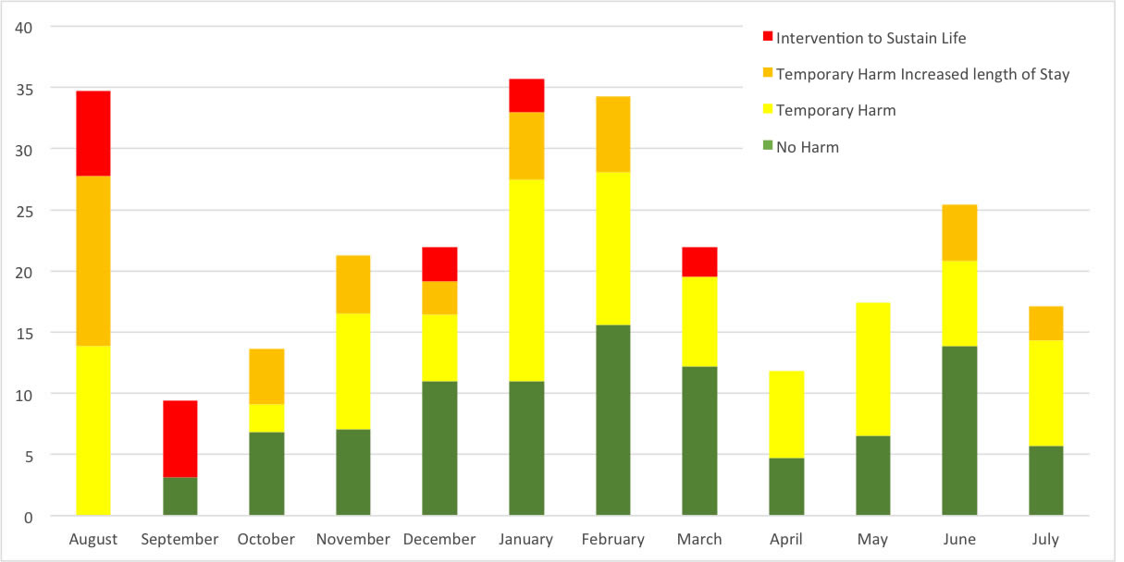
Rapid improvements in quality and safety following introductions of tracheostomy multi-disciplinary team ward rounds at a tertiary hospital
J Lynch*, S Wallace$, B Bonvento%, G Sharp@, S Pieri-Davies!, BA McGrath⁺
*Tracheostomy QI Project Lead (ICU Charge Nurse), $Speech & Language Therapist, %Critical Care Physiotherapist, @Critical Care Outreach, !LTVS Consultant Physiotherapist, ⁺ICU Consultant
Acute Intensive Care Unit, University Hospital South Manchester, Southmoor Road, Wythenshawe, Manchester. M23 9LT.
Tracheostomy Multi-Disciplinary Team (TMDT) care involves interactions between multiple teams in complex patients. TMDT ward rounds have shown improvements in patient outcomes but most published series to date took several years to demonstrate an impact. The Global Tracheostomy Collaborative (GTC) Quality Improvement (QI) programme supports rapid adoption of QI initiatives from exemplar centres, tracking patient metrics, surrogate markers of quality and adverse events. Our aim was to rapidly implement best practice TMDT ward rounds and evaluate their effectiveness.
UHSM manages around 200 tracheostomy patients annually and joined the GTC in July 2014. We collected baseline data for 20 weeks before implementing weekly TMDT ward rounds reviewing ICU and non-ENT ward-based patients. TMDT typically comprised consultant intensivist, speech and language therapist (SLT), physiotherapist, ENT specialist nurse, critical care outreach sister and a long-term ventilation specialist. We hypothesised that TMDT interventions and recommendations would directly impact upon rates of accidental decannulation, tube obstruction and patient centred outcomes.
Our detailed analysis was part of the Shine Project, funded by The Health Foundation: an independent charity working to improve the quality of healthcare in the UK. Data were entered into the GTC database and analysed using SPSS
TMDT undertook 84 reviews and made 92 separate interventions or recommendations in 28 patients. Direct interventions (dressing and tube changes, endoscopy, swallowing assessment, decannulation), referrals, planned later interventions and bedside staff education and training resulted. Accidental decannulation was reduced to zero (Fisher’s exact p=0.02) There was a non-significant reduction in tracheostomy-related critical incidents resulting in harm, from 21.7 to 11.8 per 1000 tracheostomy bed days (p=0.26) with a reduction in the severity of incidents also observed (bar chart, left). Nonparametric linear regression with Cuzick’s trend test determined a significant reduction in both ICU (median slope -1.9, p=0.04 ) and hospital length of stay (-2.4, p=0.02) during the study period.
TMDT ward rounds in our hospital rapidly impacted on frequency, nature and severity of tracheostomy-related adverse events by adopting interventions and resources from international exemplar institutions. Lengths of stay were also reduced, likely reflecting an increase in the quality of care, less fragmented care, and the ability of the TMDT to arrange interventions in a timely manner appropriate to the patient’s progress.
References
Zhu H, Das P, Woodhouse R, & Kubba H. Improving the quality of tracheostomy care. Breathe, 2014;10:286-294.
Brown DJ, Cameron TS, Donoghue FJ, et al. Outcomes of patients with spinal cord injury before and after introduction of an interdisciplinary tracheostomy team. Critical Care and Resuscitation 2009;11:14-19.
Cetto R, Arora A, Hettige R, et al Improving tracheostomy care: a prospective study of the multidisciplinary approach. Clinical Otolaryngology, 2011;36:482-488.
Tobin AE & Santamaria JD. An intensivist-led tracheostomy review team is associated with shorter decannulation time and length of stay: a prospective cohort study. Critical Care, 2008;12:R48.
Speed L, & Harding KE. Tracheostomy teams reduce total tracheostomy time and increase speaking valve use: a systematic review and meta-analysis. Journal of critical care, 2013;28:216-e1.
www.globaltrach.org www.tracheostomy.org.uk

